Slide 1
MD5
A Hash Algorithm…

Slide 2
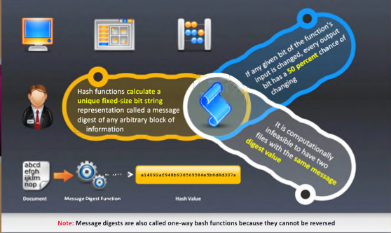
MD5

Slide 3
Why HASH?
Fingerprint of message does not tell anything about the message.
This is because there are infinite other possible equations which can produce same result.

Slide 4
Principle Of MD
Easy to Compute
Same message same MD
Difficult to reverse
Different message different MD
Collision
Birthday Paradox for collision detection

Slide 5
History
Series of MD algorithm.
Original message digest algorithm called as MD.
MD2 (1989) for 8 bit PC, rounds18 found to be quite weak.
MD3 was failure never released.
MD4 (1990) digest length128 bits rounds 3, found to wantig.
MD5 (1992) we will discuss it in details.
MD6 (2008) variable digest size up to 512 bits & rounds.

Slide 6
How MD5 Works?
Digest Length=128 bit
I/P Text=512 bit
Sub Block size-32bit
512/32=16 total Sub blocks
No. Of Rounds=4
Iteration per round=16
Chaining Variable = 4*32=128
K[t] constant = Where t=0 to 63
O/P-> four 32 bit blocks

Slide 7
Steps
Padding
Append length
Divide the I/P in 512 bit blocks
Initialize chaining variables
Process blocks
Copying chaining variables into temporary var.
Sub blocks within a block
i/p to round temp var,16 bit sub block ,constant [t]

Slide 8
Step 4.Initialize chaining variables
A 128 bit buffer (4 registers) is used to hold the intermediate and final result of the hash function. They are initialized to the following values: A = 01234567 B = 89ABCDEF C = FEDCBA98 D = 76543210

Slide 9
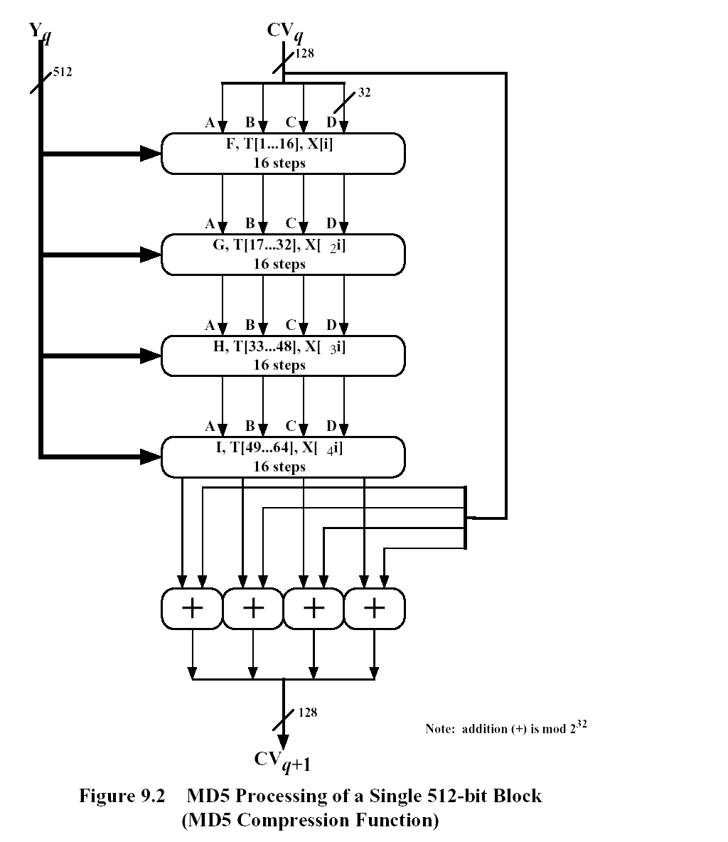
At this point the message is passed in blocks of 512 bits through the compression function as seen below:

Slide 10
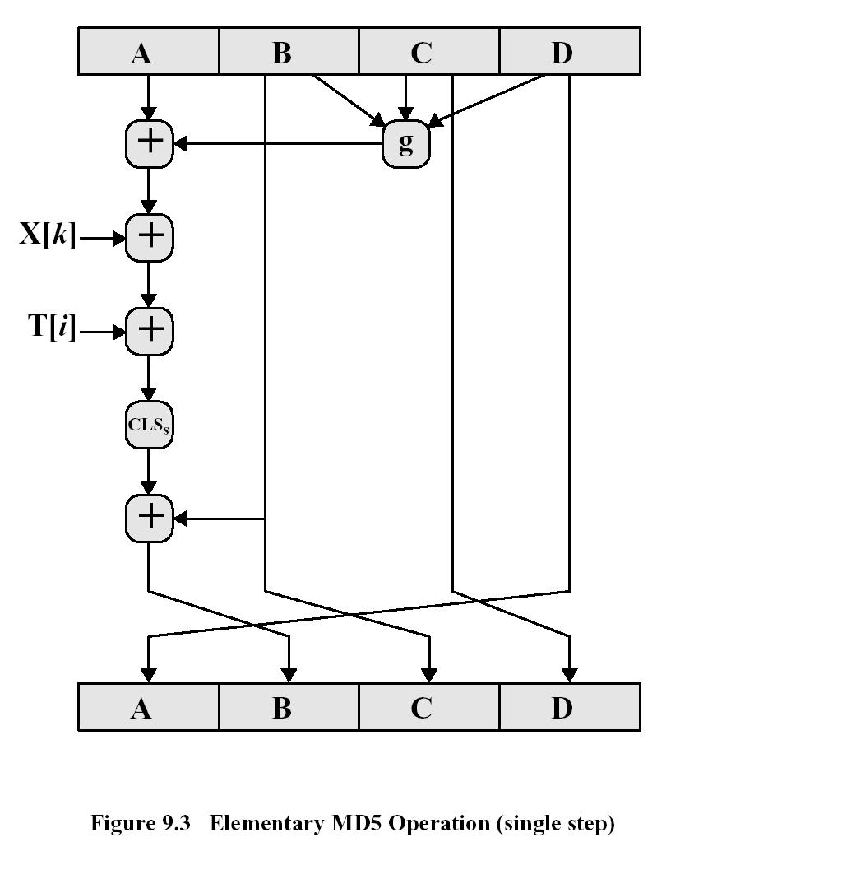
After all the 512 bit blocks have been processed a 128 bit message digest is produced, which is a function of all the bits of your message. The operations of the Functions F, G, H, I can be expressed by the following diagram:

Slide 11
Understanding The Process P
where g can be expressed as: ROUND 1: (b AND c) OR (b`AND d) ROUND 2: (b AND d) OR (c AND d`) ROUND 3: b XOR c XOR d ROUND 4: c XOR (b OR d`)

Slide 12
MD5 v/s MD4
Point of discussion | MD4 | MD5
Number of Rounds | 3 | 4
Use of Additive Constant t | Same for all the iteration | Different for all the iteration
Process P | Less Random | More Random
Security | Less | More

